Slide 1

TOOLS OVERVIEW –
ActivityTrak®

Slide 2

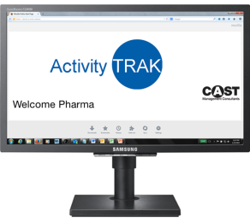
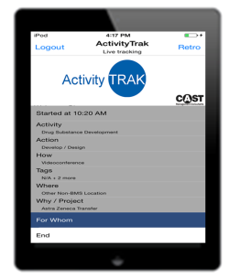
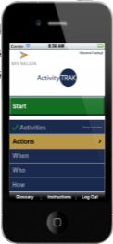
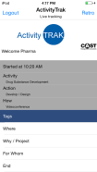
ActivityTrak® – A Custom Designed Application
HOW IS IT USED?
CAST’s Proprietary Open Framework Data Collection Tool
®
Quantify and characterize the activities performed over a specific period of time by each role
Measure the duration and frequency of activities and identify internal best practices
KEY FEATURES
Identify and quantify the equipment and facilities used by a workforce
Web Browser
Disaggregates processes and activities at the person / role level:
Who performs the task
When; time, day, shift, cycle
Where; desk; home; conference room
Duration; time to complete
Provides a composite view of activities completed by position and where and how those activities are performed
Statistically valid basis to measure capacity / drive cost-benefit analyses
Identifies and measures variances by location, experience, customer, approach, technology, legacy acquisitions, etc.
Quantifies the capacity potential of facilities
How is the task performed
Whether Customer / Non-Customer facing
Tracks activities across multiple roles, units, dependencies
®
Tablets
Smart Phones

Slide 3
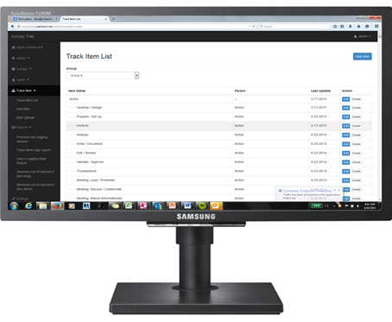





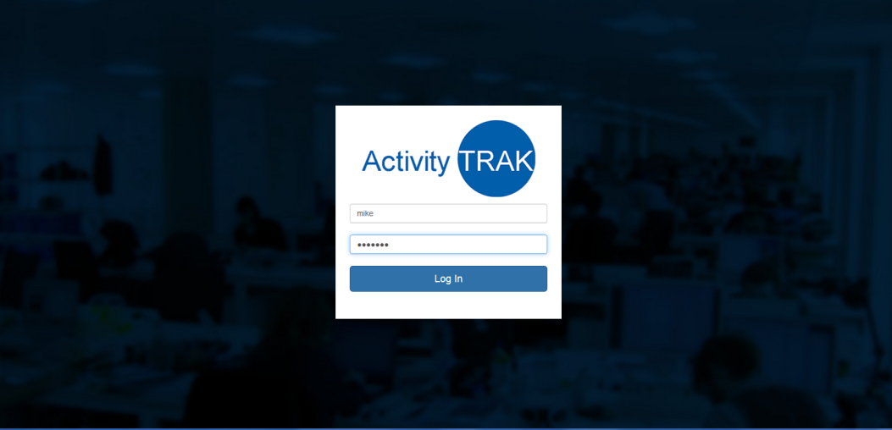


How ActivityTrak Works – Major Components
ActivityTrak®
Central Command Center
Cloud Server
(API & MYSQL DB)
MDM Server
Analytics Platform(s)
ActivityTrak® Data Capture (iOS & Web)

Slide 4


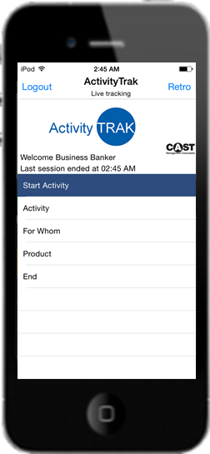

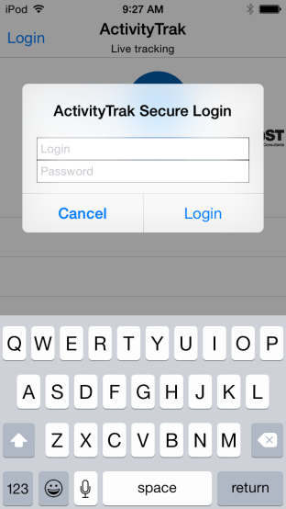
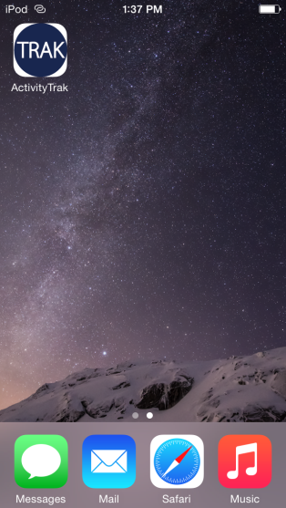
How ActivityTrak Works – Data Flow
App Push
Latest version of ActivityTrak App is pushed to all iPods in Study

Slide 5



How ActivityTrak Works – Data Flow
CAST Study Setup
After hypothesis workshop has been completed, CAST team will input core App Content into Central Command Center
Client Specific ActivityList
User Names
Etc

Slide 6

How ActivityTrak Works – Data Flow
User App Content Download
App Content is pushed to the iPod when the user first logs in
m
r
a
y
m
o
n
d
*
*
*
*

Slide 7


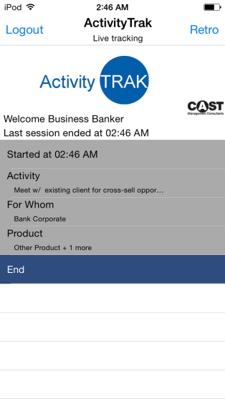
How ActivityTrak Works – Data Flow
Tracking Data Uploads
Tracked Sessions are automatically pushed to the cloud Server every 5 min
Session Data is Automatically transferred into tableau for real-time analytics*
*Tableau implementation is still in beta

Slide 8
Upcoming ActivityTrak Workshop Topics
ActivityTrak Project Methodology
Sales Strategy & The Hypothesis Workshop
Hands-on: Build your own ActivityTrak Study

Slide 9
ActivityTrak Sales Methodology

Slide 10

ActivityTrak Introduction & Hypotheses Working Session
March 18th, 2015
This document is proprietary in nature and is provided for the exclusive use of Allianz personnel.
The contents are not to be shared with outside parties unless prior written consent is obtained from CAST Management Consultants, Inc.

Slide 11
What we do…
We assist leadership teams to move beyond instinct and intuition
We help teams to anchor their decision-making in detailed knowledge of exactly what operational performance currently means
We work with companies to build an ironclad evidence platform
We work with our clients to take ideas about opportunities to create evidenced-based insights to improve dramatically the quality, the speed, and the benefit realization of the opportunities
SUPPOSITION
CONVICTION
ACTION

Slide 12
Our detailed design framework is thorough and comprehensive
CAST Approach
DISCOVERY & HYPOTHESES GENERATION
DATA COLLECTION & ANALYSIS
RECOMMENDATION DEVELOPMENT
IMPLEMENTATION
Major Activities:
Develop a baseline of operations through interviews, documentation review and process observations
Develop attributes and corresponding values
Design attribute survey for user review and approval
Develop any additional hypotheses for exploration
Imagine the impact of the hypotheses
Create a customized data collection platform
Major Activities:
Train participants to collect data accurately
Produce progress reports and perform real time QC
Capture unique organizational data
Begin preliminary analyses on data by segmenting by department, job grade, and macro-level categories
Analyze, configure and highlight results based on hypotheses
Major Activities:
Validate initial hypotheses
Present initial results based on hypotheses
Identify additional segmentation of the data to gain more insight into hypotheses
Identify preliminary opportunities based on hypotheses outcomes
Begin quantifying benefits
Facilitate recommendation workshop
Major Activities:
Prioritize opportunities based on data analysis
Create a detailed future state design
Develop detailed implementation plans with sequencing
Develop a communication plan
Develop a status reporting and accountability structure
Senior
INDICATIVE DURATION:
4-6 WEEKS
INDICATIVE DURATION:
4-6 WEEKS
INDICATIVE DURATION:
2-4 WEEKS
INDICATIVE DURATION:
2-6 WEEKS

Slide 13
ActivityTrak® – A Custom Designed Application
Our ActivityTrak application is custom designed to capture the data that will provide insight into your unique hypotheses and then is tailored to support how work is accomplished in your environment
ACTIVITY
COMPLETED
AND
SELECTIONS
MADE
Begin activity session
Session completed with selections visible

Slide 14
Why we believe data are useful … a Finance example
CONVENTIONAL WISDOM
EVIDENCE-BASED FINDINGS
The Finance organization needs to be close to the Executive Committee and the lines of business because there is a high rate of interaction
On average the Finance organization spent 3% of their time interfacing in person with the executive committee or the line of business
The Finance organization spends a significant amount of time providing ad hoc information to the parent company in Europe
On average the Finance organization spent 7% of the time performing ad hoc activities for the parent company in Europe
Work within the Finance organization is more or less appropriately aligned based on the compensation level of the employee
Across Finance, 45% of the time captured was spent gathering, inputting or balancing data and 22% of the time it was performed by the highest compensated individuals
Reduction in Demand and Process Improvement are the greatest sources of opportunity at the beginning of the study
Demand and Process Improvement accounted for only 20% of the overall identified benefit to the Finance organization

Slide 15
In one of our most recent customized platforms, around 1.25 billion combinations were “track-able”
Example – Action-Activity Combinations
DEPARTMENT | ACTION OPTIONS | ACTIVITY OPTIONS | TYPE OPTIONS | FOR WHOM OPTIONS | WHERE OPTIONS | HOW OPTIONS | PROCESS IMPACT OPTIONS | TOTAL OPTIONS
Expense Control | 6 | 72 | 3 | 19 | 5 | 14 | 2 | 3,447,360
Sourcing & Procurement/AP | 6 | 84 | 3 | 19 | 5 | 17 | 2 | 4,883,760
Business Area CFOs | 7 | 60 | 6 | 25 | 5 | 16 | 6 | 30,240,000
Corporate Real Estate | 6 | 58 | 5 | 27 | 5 | 15 | 6 | 21,141,000
Operations/Special Projects | 6 | 104 | 6 | 26 | 5 | 24 | 11 | 128,494,080
Controllers | 7 | 76 | 6 | 27 | 5 | 22 | 7 | 66,361,680
Financial Information Management | 7 | 50 | 6 | 29 | 5 | 15 | 5 | 22,837,500
Tax | 7 | 153 | 6 | 39 | 5 | 16 | 6 | 120,294,720
Reinsurance | 7 | 246 | 6 | 39 | 5 | 16 | 6 | 193,415,040
Corporate Actuarial | 7 | 226 | 6 | 39 | 5 | 16 | 6 | 177,690,240
Investments | 7 | 151 | 6 | 39 | 5 | 16 | 6 | 118,722,240
Hedging & Treasury | 7 | 207 | 6 | 39 | 5 | 16 | 6 | 162,751,680
Risk Management | 7 | 249 | 6 | 39 | 5 | 16 | 6 | 195,773,760
 |  |  |  | TOTAL POSSIBLE COMBINATIONS |  |  |  | 1,246,053,060

Slide 16
Viewing activities at a categorical level provides a comprehensive view and direction on where to focus
Example – Activity Categorization
CATEGORY | # OF UNIQUE ACTIVITIES | # OF SUB-CATEGORIES | % OF TIME | % OF COST
Reporting | 361 | 26 | 23.4% | 22.4%
Administrative | 116 | 7 | 18.4% | 20.0%
Modeling | 130 | 17 | 11.5% | 11.4%
Accounting | 115 | 11 | 13.3% | 9.3%
Departmental Operations | 212 | 9 | 9.6% | 8.9%
Special Projects | 60 | 3 | 5.5% | 6.8%
Controls | 116 | 8 | 5.7% | 6.3%
Strategic Plan, Budget, Forecasting | 40 | 5 | 4.8% | 5.3%
Corporate Governance | 80 | 7 | 3.1% | 4.4%
Corporate Tax | 41 | 5 | 2.1% | 2.6%
Other | 38 | 3 | 2.7% | 2.6%
Total | 1,309 | 101 | 100.0% | 100.0%

Slide 17
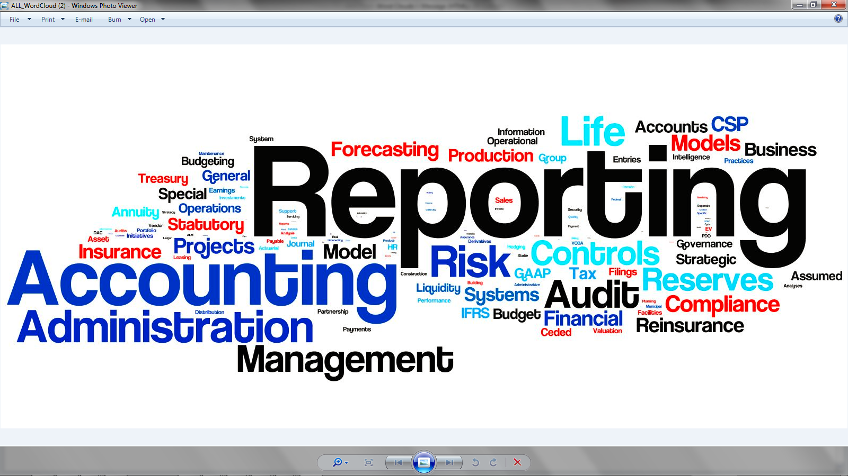
Activity Survey results can powerfully challenge what is held to be important

Slide 18
Ensuring the data being captured are of the highest standard is a key component of the overall program
Quality Control
Common issues or anomalies that are quality controlled include:
Low session counts, low daily tracked hours, high session times and/or overnight sessions

Slide 19
Common participant reactions when asked to begin using ActivityTrak
Common Reactions
“Are you questioning my value?” – These exercises are not focused on individual performance
“I am already overwhelmed” – ActivityTrak is a minimally invasive application
“I’m overqualified for this type of exercise” – Activity data are best captured by all
“People will finally see all that I do” – Both good and bad
“Will this enhance the customer and user experience?” – An evidence base can be enriched with surveys to make smarter choices that are reasoned rather than responding to loudest requester
“Will this free up time for me to think and to grow?” – That is the plan
“Can we eliminate excess handoffs and help to sort out process overlaps?” – One output will be data to aid in the identification of potential process inefficiencies and redundancies
“Get the low-value activities off my plate – This exercise will identify fragmented activities and realign them based on defined skill level
“Can you help reduce the work peaks and valleys?” – Granular data capture can provide insights into volumes and timings and present strategies to flatten the work flow
“Can people work the system?” – Gaming is difficult to accomplish because there is no right answer and we will be following up frequently (daily at times) to discuss statistical outliers

Slide 20
Common practical questions can be anticipated
Common Questions
Multi-tasking – In our training sessions we discuss strategies to address how to capture this concept
Interruptions – Each ActivityTrak flow is customized by department so if fragmented processes are common we will modify the ActivityTrak application accordingly
Working Offsite– In all instances we want the participants to track all time devoted to work. The online tracking platform will be accessible via a web portal from any internet connected device
Vacation Time – The focus of the data captured is at the department level so vacation time is inconsequential as the work still gets completed when individuals are out
Special Projects – Any on-going, major projects will be accounted for in our activity discussions and built into the application
Cyclical Businesses / Seasonality – During the development process we will identify processes impacted by seasonality and account for these (captured and not captured) in our analysis

Slide 21
Levers can be pulled singularly or, more powerfully, in combination
INTERCONNECTIVITY OF HYPOTHESES / TRANSFORMATION LEVERS
DEMAND MANAGEMENT
“WHEN? WHAT? WHY?”
PROCESS IMPROVEMENTS
“HOW?”
LOCATION
“WHERE”
RESOURCE & ACTIVITY ALIGNMENT
“WHO”

Slide 22
What might be most important to you?
OBJECTIVES – FOR DISCUSSION
Creation of a consistent process for efficient leverage and utilization of resource
Identification of strategies for more effective management of demand
Rationalization and simplification of process execution between various business units and support groups
Identification and establishment of internal best practices
Identification of opportunities to manage the cost structure while improving the delivery value
Rationalization of the organization and identification of alternative configurations to provide greater value
Segmentation of roles and responsibilities to enable identification of an optimal configuration
Cost reduction
. . . . . .

Slide 23
Workshop: Introduction
Observations
RAW FEEDBACK
Daily Operations
Complaints
QUESTIONS
Ideas
Hypotheses Workshop
An opportunity to step outside normal operations – to stop, to think, to question and ultimately to hypothesize
SUPPOSITIONS
TESTABLE HYPOTHESES
ACTION

Slide 24
Workshop: Introduction – Example
RAW FEEDBACK
“We spend a lot of time responding to whoever is shouting loudest from Senior Management”
SUPPOSITION
“Responding to requests from Senior Management has a tangible impact on our ability to deliver our everyday workload”
TESTABLE HYPOTHESIS
“Ad hoc work for Senior Management crowds out critical operational functions such as quality control and review”
Comprehensive data collection allows for detailed testing of a broad range of hypotheses
ACTION
Activity Breakdown – Days without Sr. Mgmt. Requests
Activity Breakdown – Days with Sr. Mgmt. Requests
Quality Control & Review Work
Quality Control & Review Work
Work for Sr. Mgmt. Requests

Slide 25
Workshop: Preparation – Common Hypothesis Drivers
Process Improvement
Manual Work
Tools & Technology
Process Design
Demand Management
Resource & Activity
Alignment
Duplicative
Requests
Expertise
Deployed on Manual
Tasks
Outdated Requests
Over-Stretched Resources
Understaffed Areas Resulting in “Stretch”
Assignments
Cost/Benefit Mismatch in Reporting
Heavy Admin. Burden
Parent Company Reporting
Under-Utilized Staff

